Slide 1
Lec 8: Classification of Systems
Dr. Arsla Khan

Slide 2
Classification of Systems
i) Causal Systems and Non-causal Systems
ii) Static Systems and Dynamic Systems
iii) Time-invariant Systems and Time-variant Systems
iv) Stable Systems and Unstable Systems
v) Linear Systems and Non-linear Systems
vi) Invertible Systems and Inverse Systems

Slide 3
1) Causal and Non-Causal Systems
Causal systems are described as:
Response of the causal system to an input does not depend on future values of that input but depends only on the present and past values of the input.

Slide 4
2) Static (memoryless) and Dynamic (with memory) Systems
Static systems are also known as memoryless systems
Static systems contain no storage elements (thus, no integrals, derivatives or signal delays)
A static or memoryless system is a system with an output signal whose values depends upon the present value of the input signal only. Otherwise the system is dynamic or with memory.

Slide 5
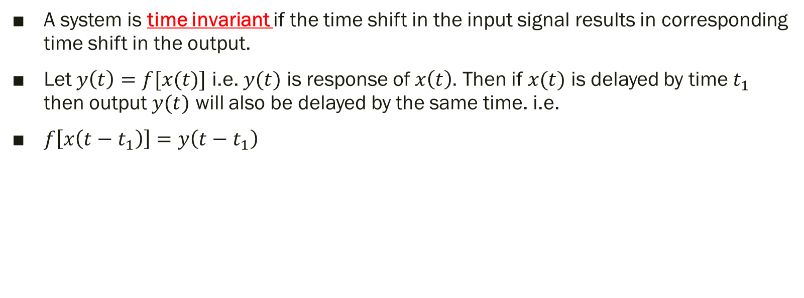
3) Time Invariant and Time Variant Systems
A system is time invariant if the time shift in the input signal results in corresponding time shift in the output.
Let $y\left(t\right)=f[x(t)]$ i.e. $y(t)$ is response of $x\left(t\right).$ Then if $x(t)$ is delayed by time $t_{1}$ then output $y(t)$ will also be delayed by the same time. i.e.
$f\left[x\left(t−t_{1}\right)\right]=y\left(t−t_{1}\right)$

Slide 6

Steps to test for time invariance property
Step 1: Determine the output of system for delayed input i.e. $x(t−t_{1})$
$y\left(t,t_{1}\right)=f[x(t−t_{1})]$
Step 2: Then delay the output itself by $t_{1}$ i.e. $y(t−t_{1})$
Step 3: If
$y\left(t,t_{1}\right)≠y(t−t_{1})$ → Time variant
$y\left(t,t_{1}\right)=y(t−t_{1})$ → Time invariant

Slide 7
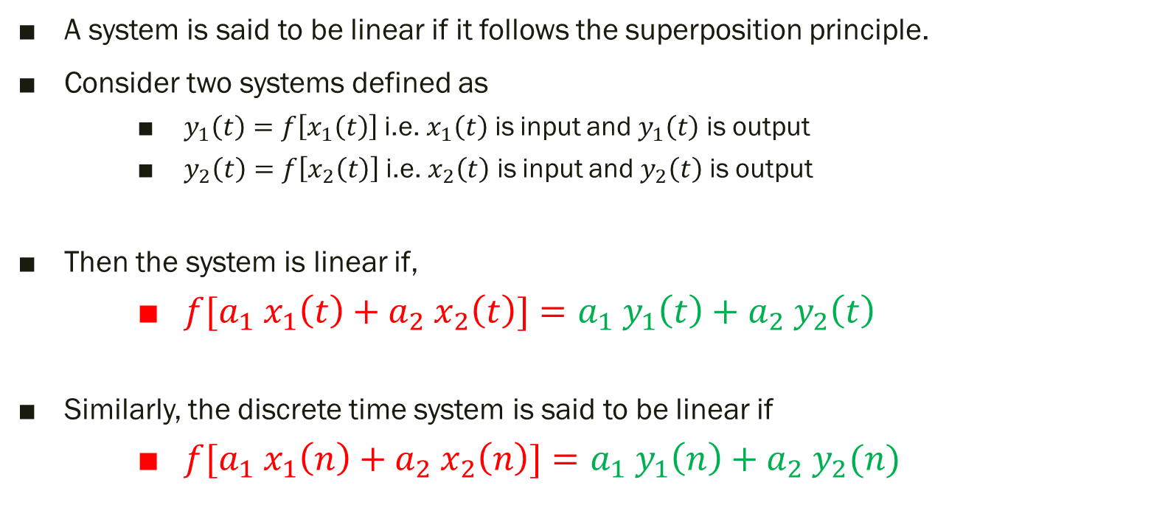
4) Linear and Non-Linear Systems
A system is said to be linear if it follows the superposition principle.
Consider two systems defined as
$y_{1}\left(t\right)=f\left[x_{1}\left(t\right)\right]$ i.e. $x_{1}\left(t\right)$ is input and $y_{1}\left(t\right)$ is output
$y_{2}\left(t\right)=f\left[x_{2}\left(t\right)\right]$ i.e. $x_{2}\left(t\right)$ is input and $y_{2}\left(t\right)$ is output
Then the system is linear if,
$f[a_{1} x_{1}\left(t\right)+a_{2} x_{2}\left(t\right)]=a_{1} y_{1}\left(t\right)+a_{2} y_{2}\left(t\right)$
Similarly, the discrete time system is said to be linear if
${f[a}_{1} x_{1}\left(n\right)+a_{2} x_{2}\left(n\right)]=a_{1} y_{1}\left(n\right)+a_{2} y_{2}(n)$

Slide 8




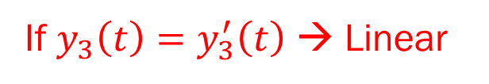

$$a_{1}x_{1}(t)$$
$$=f[a_{1}x_{1}\left(t\right)+a_{2}x_{2}(t)]$$
$$a_{2}x_{2}(t)$$
$$y_{1}(t)$$
If $y_{3}\left(t\right)=y_{3}^{′}\left(t\right)$ → Linear
$$y_{2}(t)$$

Slide 9

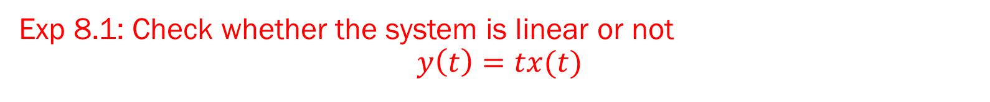

Exp 8.1: Check whether the system is linear or not $$y\left(t\right)=tx(t)$$
For RHS
Consider two systems
$y_{1}\left(t\right)=tx_{1}\left(t\right)$
$y_{2}\left(t\right)=tx_{2}\left(t\right)$
$y_{3}^{′}\left(t\right)=a_{1}y_{1}\left(t\right)+$ $a_{2}y_{2}\left(t\right)$
$y_{3}^{′}\left(t\right)=a_{1}tx_{1}\left(t\right)+$ $a_{2}tx_{2}\left(t\right)$
For LHS
$y_{3}\left(t\right)=f\left[{a_{1}x}_{1}\left(t\right)+{a_{2}x}_{2}\left(t\right)\right]$
$=t$ (${a_{1}x}_{1}\left(t\right)+{a_{2}x}_{2}\left(t\right))$
$=t$ ${a_{1}x}_{1}\left(t\right)+{{ta}_{2}x}_{2}\left(t\right)$
Since $y_{3}\left(t\right)=y_{3}^{′}\left(t\right)$ → Linear

Slide 10
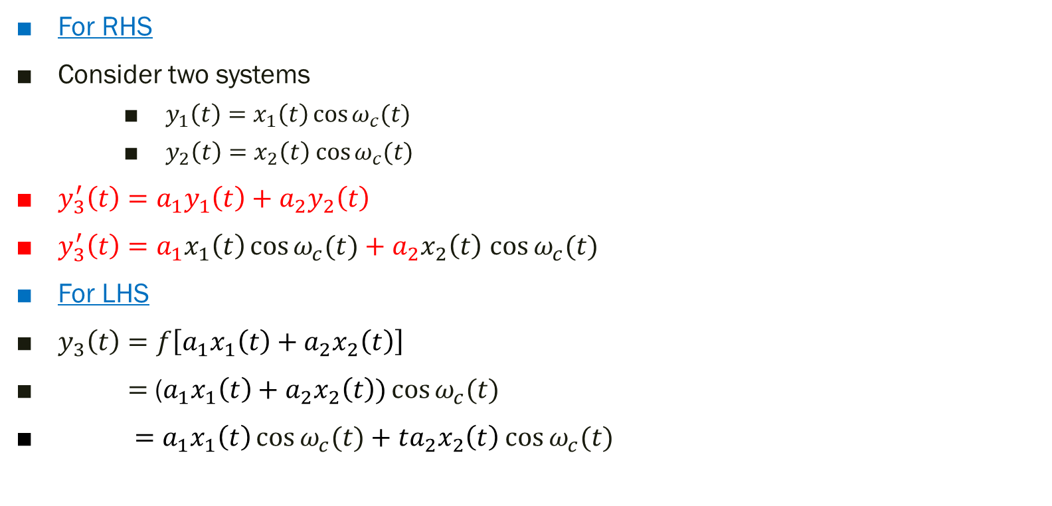

ii) $y\left(t\right)=x\left(t\right)cosω_{c}(t)⁡$
For RHS
Consider two systems
$y_{1}\left(t\right)=x_{1}\left(t\right)\cos{ω_{c}(t)}$
$y_{2}\left(t\right)=x_{2}\left(t\right)$ $\cos{ω_{c}(t)}$
$y_{3}^{′}\left(t\right)=a_{1}y_{1}\left(t\right)+$ $a_{2}y_{2}\left(t\right)$
$y_{3}^{′}\left(t\right)=a_{1}x_{1}\left(t\right)\cos{ω_{c}(t)}+$ $a_{2}x_{2}\left(t\right)$ $\cos{ω_{c}(t)}$
For LHS
$y_{3}\left(t\right)=f\left[{a_{1}x}_{1}\left(t\right)+{a_{2}x}_{2}\left(t\right)\right]$
$=$ (${a_{1}x}_{1}\left(t\right)+{a_{2}x}_{2}\left(t\right))\cos{ω_{c}(t)}$
$=$ ${a_{1}x}_{1}\left(t\right)\cos{ω_{c}(t)}+{{ta}_{2}x}_{2}\left(t\right)$ $\cos{ω_{c}(t)}$
Since $y_{3}\left(t\right)=y_{3}^{′}\left(t\right)$ → Linear

Slide 11


iii) $y\left(t\right)=x^{2}(t)$
For RHS
Consider two systems
$y_{1}\left(t\right)=x_{1}^{2}(t)$
$y_{2}\left(t\right)=x_{2}^{2}(t)$
$y_{3}^{′}\left(t\right)=a_{1}y_{1}\left(t\right)+$ $a_{2}y_{2}\left(t\right)$
$y_{3}^{′}\left(t\right)=a_{1}x_{1}^{2}(t)+$ $a_{2}x_{1}^{2}(t)$
For LHS
$y_{3}\left(t\right)=f\left[{a_{1}x}_{1}\left(t\right)+{a_{2}x}_{2}\left(t\right)\right]$
$={{{[a}_{1}x}_{1}\left(t\right)+{a_{2}x}_{2}\left(t\right)]}^{2}$
$=$ $a_{1}^{2}x_{1}^{2}\left(t\right)+a_{2}^{2}x_{2}^{2}\left(t\right)+2{a_{1}a_{2}x}_{1}\left(t\right)$ $x_{2}(t)$
Since $y_{3}\left(t\right)≠y_{3}^{′}\left(t\right)$ → Non-Linear

Slide 12
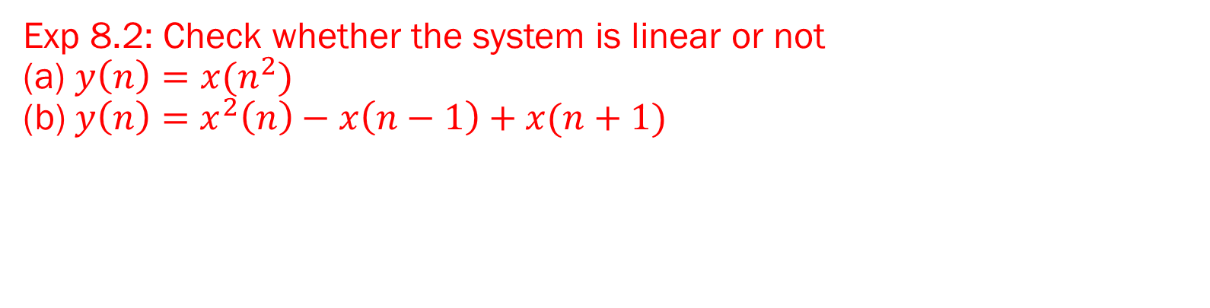
Exp 8.2: Check whether the system is linear or not (a) $y\left(n\right)=x(n^{2})$ (b) $y\left(n\right)=$ $x^{2}\left(n\right)−x\left(n−1\right)+x(n+1)$

Slide 13

5) Stable and Unstable Systems
When every bounded input produces bounded output. It is called Stable System.
Follows BIBO
If $\left|x(t)\right|≤M_{x}<∞$
$\left|x(n)\right|≤M_{x}<∞$
Then O/P is
$\left|y(t)\right|≤M_{y}<∞$
$\left|y(n)\right|≤M_{y}<∞$
Bounded Input
Bounded Output

Slide 14

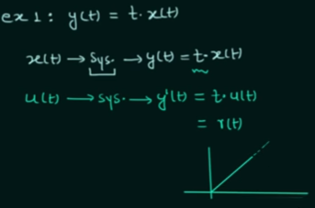
unstable

Slide 15

Exp 8.3: Check whether the system is stable or not
(a) $y\left(t\right)=tx(t)$
unStable
(b) $y\left(t\right)=x\left(t\right)sin100πt$
Stable
(c) $y\left(n\right)=r^{n}x(n)$ $r>1$
Unstable because the value of $y\left(n\right)$ is not only depending upon $x(n)$ but also upon $r$ which can be unbounded.

Slide 16
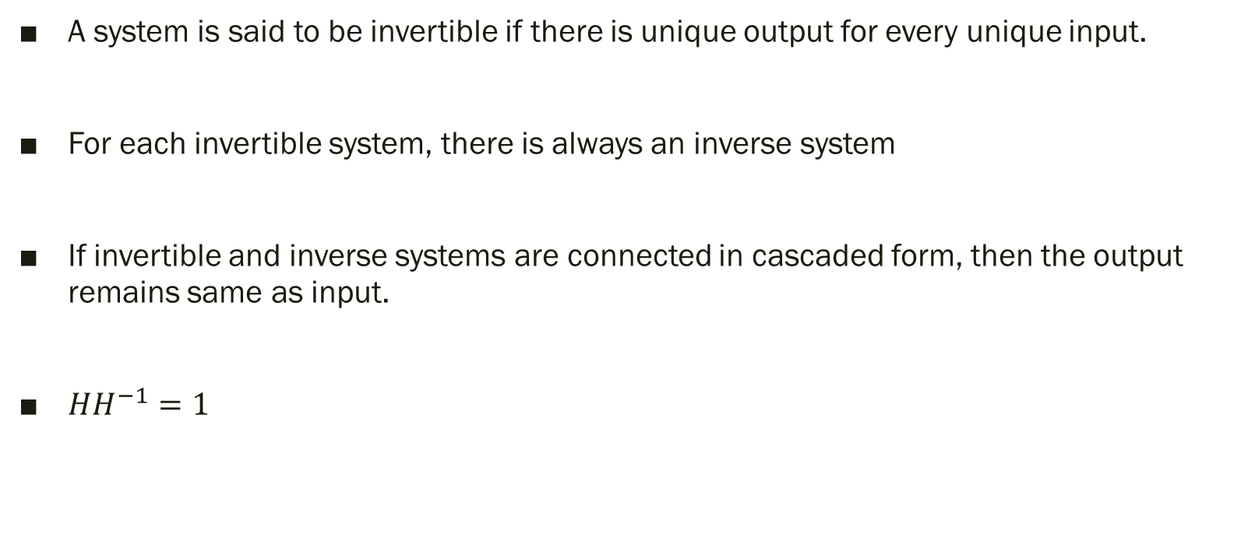
6) Invertible and Inverse Systems
A system is said to be invertible if there is unique output for every unique input.
For each invertible system, there is always an inverse system
If invertible and inverse systems are connected in cascaded form, then the output remains same as input.
$HH^{−1}=1$

Slide 17
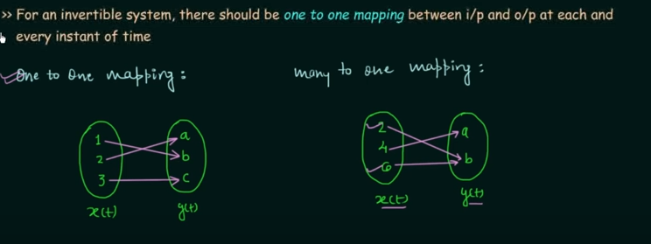
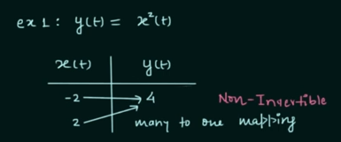
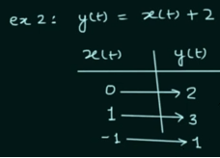

Slide 18

Exp 8.4: Check whether the system is invertible or not
(a) $y\left(t\right)=10x(t)$
Invertible
(b) $y\left(t\right)=x^{2}(t)$
It is non-invertible

Slide 19
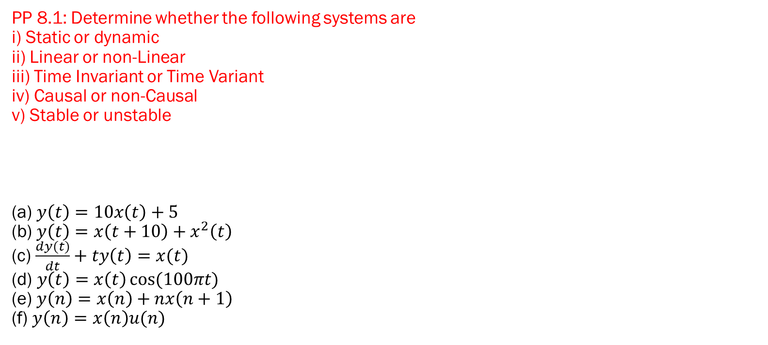
PP 8.1: Determine whether the following systems are i) Static or dynamic ii) Linear or non-Linear iii) Time Invariant or Time Variant iv) Causal or non-Causal v) Stable or unstable (a) $y\left(t\right)=10x\left(t\right)+5$ (b) $y\left(t\right)=x\left(t+10\right)+x^{2}\left(t\right)$ (c) $\frac{dy(t)}{dt}+ty\left(t\right)=x(t)$ (d) $y\left(t\right)=x\left(t\right)\cos{(100πt)}$ (e) $y\left(n\right)=x\left(n\right)+nx\left(n+1\right)$ (f) $y\left(n\right)=x\left(n\right)u(n)$

Slide 20
Thank You !!!

